Slide 1
Test to Failure of 3/8-Inch Tube Ferrule Connections in an Effort to Determine the Shear Strength of a Varying Number of Threads Engaged

Slide 2
Test Objectives
Determine maximum pressure loads on 3/8-inch tube ferrule connections for a varying number of threads engaged in an effort to determine the shear strength of those threads engaged

Slide 3
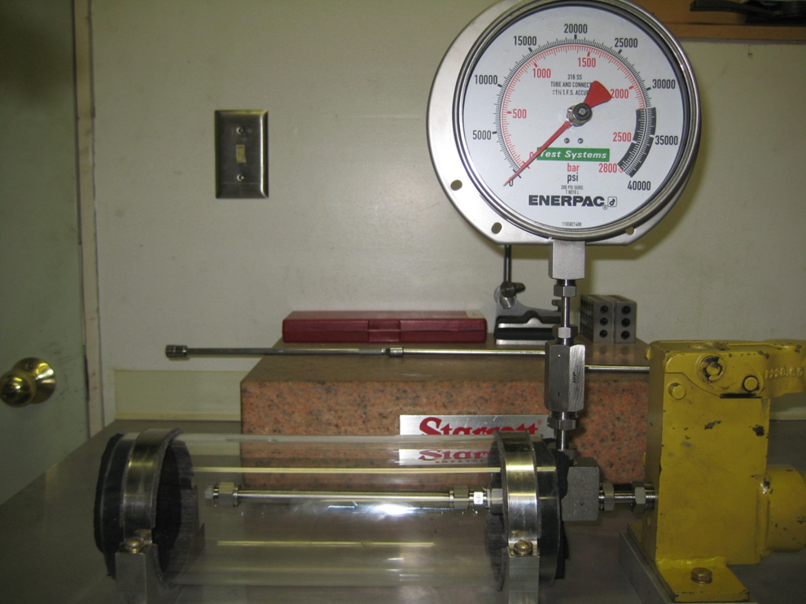
Test Apparatus
Enerpac Ultra High-Pressure Hydraulic Hand Pump
Model No. P-2282
Pressure Range 0 – 40,000 psi
Enerpac Calibrated Test Gauge
PSI Part No. T-6010L
Range 0 – 40,000 psi
Enerpac Hydraulic Oil LX
Ultra High Pressure Test Apparatus

Slide 4
Test Article Assemblies
Three test articles were assembled and tested. These articles consisted of the following and allowed for the simultaneous testing of two fitting nuts.
7-inch long, 3/8-inch, 0.035 wall thickness, seamless stainless steel tubing conforming to ASTM A213/A269
Swagelok 3/8-inch stainless steel tube fitting, Part No SS-600-1-4 (used for all tests)
Swagelok 3/8-inch stainless steel fitting nut, Part No. SS-602-1 with front and back ferrules (replaced new for each test)
Swagelok 3/8-inch stainless steel cap, Part No. SS-600-C (used for all tests)

Slide 5
Test Methodology
Three were conducted
Test 1 – Utilized fully threaded fitting nuts at each end of the test article representing a new undamaged nuts.
Test 2 – Utilized a fully threaded fitting nut at one end and a nut with one thread removed at the other.
Test 3 – Utilized a fitting nut with two threads removed at one end and three threads removed at the other.
Fitting nuts with threads removed were tapped using a KnechtionRepair Tap Kit for the cleaning of the remaining threads.
The same conditions were used for all tests. Variation in test articles existed only in the number of threads engaged in each fitting nut.

Slide 6
Test Methodology (Continued)

Slide 7
Test Results
Failure of all three test articles occurred with the bursting of the seamless stainless steel tube wall at a pressure of approximately 15,000 psig (±200 psig) at a test temperature of 72ºF.
No test fluid leaks were observed during the conduct of the test prior to bursting of the tube wall.
No observable yielding of the thread by 10X visual inspection.
For all variation in the number of threads engaged, the conclusion is the threaded ferrule connection possesses significantly greater residual strength than did the seamless stainless steel tubing under the imposed pressure loading.

Slide 8
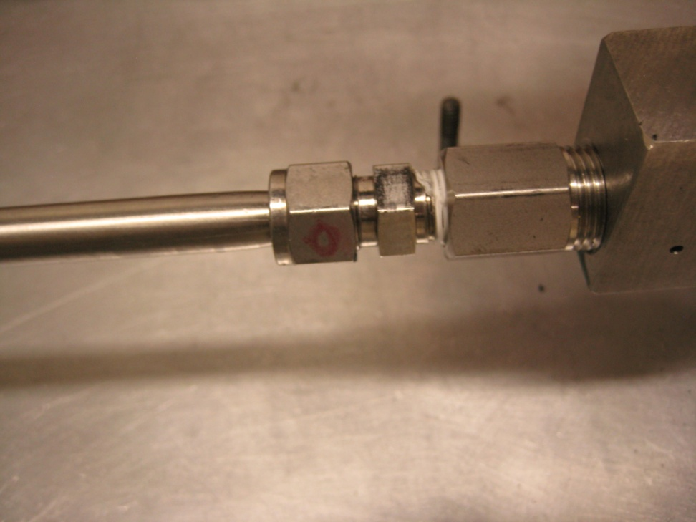
Test 1 - Fully Threaded Fitting Nuts
Assembled Test Connection (Typical) Prior to Pressure Test
Test Connection Following Pressure Test (Note tube swelling due to applied pressure 4.5x tube’s pressure rating)

Slide 9
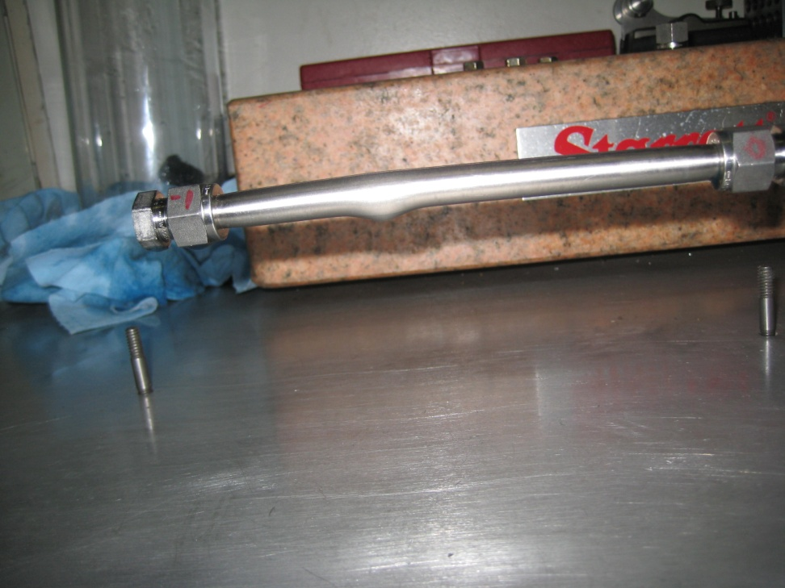
Test 2 – One Fully Threaded Fitting Nut and One Fitting Nut with One Thread Removed
Nut with single thread removed
Note ruptured tube wall
Nut with full thread amount
Assembled Test Connection Prior to Pressure Test
Test Connection Following Pressure Test (Tube burst at 15,000 psig, no fitting leaks observed)
Thread removed by turning pre-swaged assembled fitting on engine lathe. Following turning, the nut was tapped using KnechtionRepair tools and the fitting and nut reassembled per Swagelok recommendations.

Slide 10
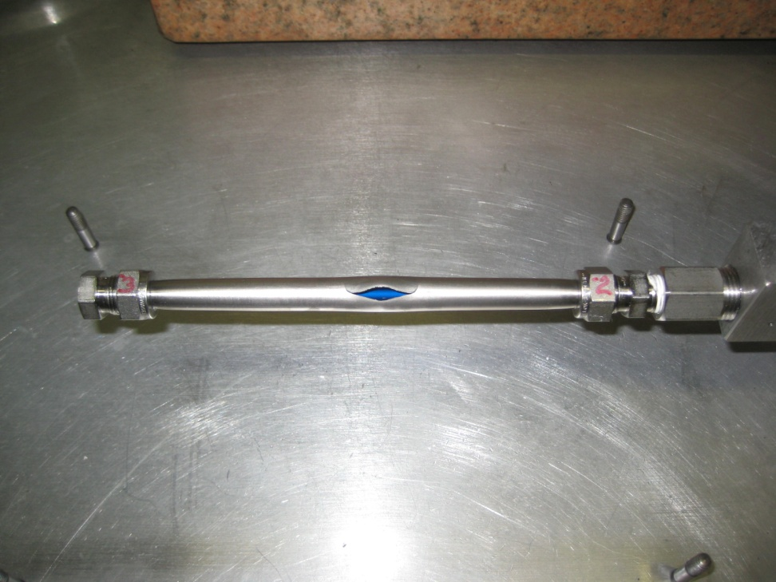
Test 3 – One Fitting Nut with Two Threads Removed and One Fitting Nut with Three Threads Removed
Nut with 3 threads removed
Ruptured tube wall
Nut with 2 threads removed
Assembled Test Connection (Typical) Prior to Pressure Test
Test Connection Following Pressure Test (Tube burst at 15,000 psig, no fitting leaks observed)
Threads were removed by turning pre-swaged assembled tube fittings on engine lathe. Following turning, the nuts were tapped using KnechtionRepair tools and the fittings and nuts reassembled per Swagelok recommendations.

Slide 11
Test 3 Fitting Nut Preparation
Test 3 Fitting Nut Following Thread Removal by Turning on an Engine Lathe
All Nuts with a Thread or Threads Removed were Tapped Following Turning using The KnechtionRepair 3/8-Inch Tap Kit

Slide 12
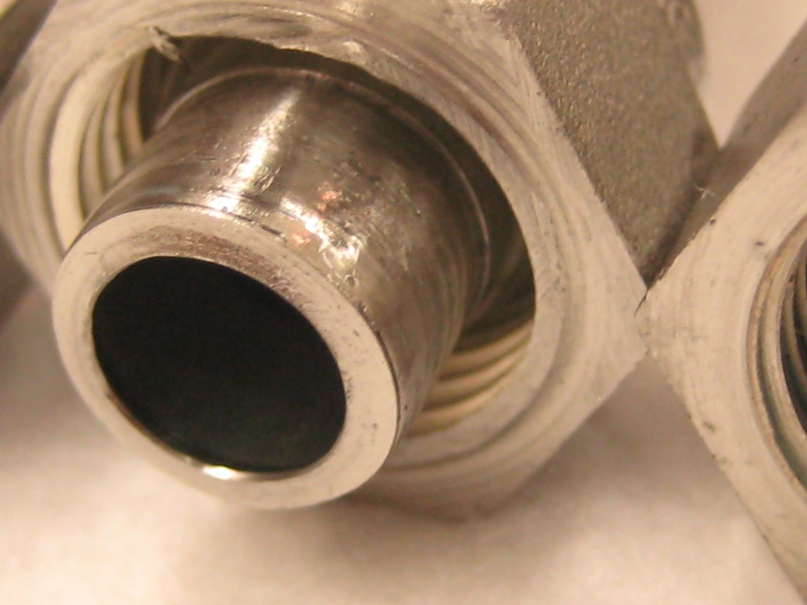
Test Articles Following Testing
Note shortened nuts for those with threads removed
No visible thread damage following testing
Test Articles Following Tube Burst Failure at 15,000 psig (±200 psig)
Test 3 Nut with 3 Threads Removed Following Testing to 15,000 psig (±200 psig)
During testing there were no observed leaks or fitting failures

Slide 13
Conclusions
Under an applied pressure load of 15,000 psig (±200 psig) failure of the all three test articles was dictated by rupture of the 3/8-inch diameter, 0.035 inch wall thickness, seamless stainless steel tubing.
For the three tests conducted, no leakage was observed at the tube fittings indicating a leak proof connection even with up to three threads removed from the fitting nuts.
From the tests conducted, it can be deduced that there is sufficient reserve strength in the remaining threads of a 3/8-inch Swagelok ferrule connection, with up to three threads removed, when properly made up to Manufactures' assembly instructions.

Slide 14
Conclusions (Continued)
Failure of the test articles was governed not by the ferrule connections but rather by the rupture of the tubing wall at pressures far exceeding allowable design pressure loads.
DISCLAIMER – The integrity of a fitting for “Return to Service” is the responsibility of the user and/or equipment owner. KnechtionRepair is not responsible for repaired or damaged fittings, nor does it assume liability of machinery or equipment damage, injury, or loss of life resulting from a tubing failure in which KnechtionRepair tools were used.

